Slide 1
Head Start Teacher
MaKayla Duggan
January 25, 2013
Hour 4
Career/Technology Foundations

Slide 2
Introduction
To help a kid gain the skills to lead a successful life and leave a lasting impact on them must be very satisfying. That is one of the many reasons why I want to become a Head Start Teacher. Ever since I can remember, I have wanted to be a preschool teacher. However, it was not until my mom got a job as a Head Start teacher that I got specific. I have been to work with my mom a few times, and the kids are so lovable and seem like normal three and four year olds. So when my mom told me that there was more to Head Start then what meets the eye, I was curious. She told me that the Head Start program was a preschool dedicated to low income families that could not afford to go to a regular preschool. From that moment on, I knew that I wanted to help kids gain the skills they will need later on that their families may not be able to teach them. In this presentation, I will be researching the different aspects of becoming and living as a Head Start Teacher, such as the nature of work, working conditions, training, qualifications, and advancements, job outlook/employment, earnings, and my backup career.

Slide 3
Nature of Work
Work with children in groups or one on one, depending on the needs of children and the subject matter
Develop schedules and routines to ensure children have enough physical activity, rest, and playtime
Watch for signs of emotional or developmental problems in children and bring problems to the attention of parents
Plan and carry out a curriculum that targets different areas of child development, such as language, motor, and social skills
Prepare children for kindergarten by introducing concepts they will explore further in kindergarten and elementary school

Slide 4
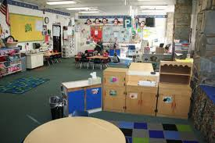
Working Conditions
Physical and Mental- hands on activities and a lot of problem solving
Indoor and Outdoor- classroom is indoors but there might be playtime outside
Hours- typically 7 a.m. to 3 p.m.
Holiday breaks, two months off in summer
Work Environment- classroom found in public or private schools, child care centers, and religious or charitable organizations

Slide 5
Training, Qualifications,
Advancement
Need at least an associates’ degree.
Many want bachelors’ degree.
Recognized certification such as the Child Care Professional or Child Development Associate
Licensed
Usually need experience as a teacher assistant or child care worker
Can work up to lead teacher
Qualities- creativity, patience, people skills, instructional skills, and communication skills
Take Early Childhood and Web Design classes in high school
Go to Central Michigan University and earn bachelors degree

Slide 6
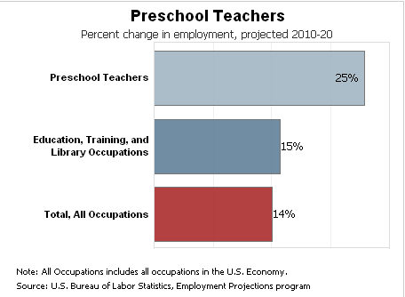
Job Outlook/Employment
Employment Rate- subject to increase by 20% in next eight years
Increasing demands for teachers due to numbers of children ages three to five
Stay in Michigan, go to school, gain experience by student teaching
Move to Petoskey, get hired there

Slide 7
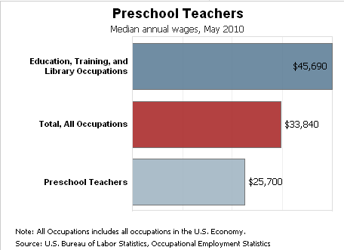
Earnings
Lifestyle Goals- live in Petoskey, have kids
Average Earnings- $25,700 a year
Not high pay
First Purchase- a house on Lake Michigan in Petoskey

Slide 8
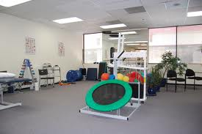
Related Occupation
Physical Therapist
Help patients manage pain and improve movement
Important in rehabilitation and treating illnesses
Most work in hospitals or offices
Always active
Full time
Doctoral degree in physical therapy
Licensed
$76,310 a year
Expected to increase 39% in next eight years
I really want to help kids and so if I cannot teach them I can help them in other ways such as helping them recover from injuries or illnesses

Slide 9
Summary
Researching the different requirements and responsibilities of becoming a Head Start Teacher has made me even more anxious to begin. I believe that this career is perfect for me, and I am looking forward to my future. The thing I look forward to the most is helping children gain certain life skills and knowledge they cannot get from home that will help them in their futures. On the other hand, I am not the most excited about all of the cleaning and preparing of crafts that goes into this career. All in all, I have learned much more about the field I have so long looked forward into going, and I will take this information and use it when looking to be hired in several years time.

Slide 10
Works Cited
http://www.naeyc.org/policy/advocacy/ProgramFacts#Head_Start_Children
http://www.bls.gov/ooh/education-training-and-library/preschool-teachers.htm

